Slide 1



Noida Institute of Engineering and Technology, Greater Noida
Acquiring & Engaging Users through Digital Channels
Unit: 3
Acquiring & Engaging Users through Digital Channels
Dr. Deepika
MBA Department
B.Tech ( AIML Semester VI)

Slide 2
Index/Content
S. No. | Index
1. | Name of Subject with code, Course and Subject Teacher
2. | Brief Introduction of Faculty member with Photograph
3. | Evaluation Scheme
4. | Syllabus
5. | Branch wise Application
6. | Course Objective(s)
7. | Course Outcome(s)
8. | Program Outcomes (POs)
9. | COs and POs Mapping

Slide 3
Index/Content
S. No. | Index
10. | Program Specific Outcomes (PSOs)
11. | Cos and PSOs Mapping
12. | Program Educational Objectives (PEOs)
13. | Result Analysis
14. | End Semester Question paper Templates
15. | Prequisite/Recap
16. | Brief Indtroduction about the Subject with Videos
17. | Unit Contents
18. | Unit Objectives
19. | Topic Objectives/Topic Outcome

Slide 4
Index/Content
S. No. | Index
20. | Lecture related to topic
21. | Daily Quiz
22. | Weekly Assignment
23. | Topic Links
24. | MCQs
25. | Glossary Questions
26. | Old question papers
27. | Expected Questions
28. | Recap of unit

Slide 5

Faculty Introduction
Pursuing Ph.D. from Noida International University
Area of Research- Human Resource Management
Done MBA
Specialization- HR & Marketing

Slide 6
Evaluation scheme

Slide 7
Syllabus
UNIT-I | Introduction to Digital Marketing | Hours- 8
Introduction to Digital Marketing: Concept of Marketing, the new digital world - trends that are driving shifts from traditional marketing practices to digital marketing practices, the modern digital consumer and new consumer’s digital journey. Marketing strategies for the digital world-latest practices.
UNIT-II | Social Media Marketing | Hours-8
Introduction to Blogging, Create a blog post for your project. Include headline, imagery, links and post, Content Planning and writing. Introduction to Face book, Twitter, Google +, LinkedIn, YouTube, Instagram and Pinterest; their channel advertising and campaigns
UNIT-III | Acquiring & Engaging Users through Digital Channels | Hours-8
Understanding the relationship between content and branding and its impact on sales, search engine marketing, overview of search engine optimization (SEO), mobile marketing, video marketing, and social-media marketing. Marketing gamification, marketing analytic tools to segment, target and position.

Slide 8
Syllabus
UNIT-IV | Designing Organization for Digital Success | Hours-8
Digital transformation, digital leadership principles, online P.R. and reputation management. ROI of digital strategies, how digital marketing is adding value to business, and evaluating cost effectiveness of digital strategies
UNIT-V | Digital Innovation and Trends |  | Hours-8
The contemporary digital revolution, digital transformation framework; security and privatization issues with digital marketing Understanding trends in digital marketing – Indian and global context, online communities and co-creation.

Slide 9
Applications
With the advent of new technologies, the field of Marketing has seen a paradigm shift over the years.
Though it is still in use, businesses across the world have switched from traditional modes of marketing to digital marketing.
This, in turn, has created many new opportunities for companies to expand their business and has created tremendous employment opportunities across sectors.
From Content curation and management to Social Media Marketing and Brand Management, a career in Digital Marketing can take you in several directions.
Top Job Profiles: Digital Marketing Manager, Social Media Manager, Content Writer, Data and Market Analytics Manager

Slide 10

Course Objectives
1 | Provide understanding of digital and social media marketing practices.
2 | Provide understanding of different social media platforms
3 | Impart learning on various digital channels and how to acquire and engage consumers online.
4 | Provide insights on building organizational competency by way of digital marketing practices and cost considerations.
5 | Develop understanding of the latest digital practices for marketing and promotion.

Slide 11

Course Outcomes
CO 1 | Develop an understanding of digital and social media marketing practices. | Knowledge (K2), Remembering (K1)
CO 2 | Develop understanding of the social media platforms | Comprehending (K 3)
CO 3 | Acquire the skill to acquire and engage consumers online | Knowledge (K2), Applying (K4)
CO 4 | Develop understanding of building organizational competency by way of digital marketing practices and cost considerations | Knowledge (K2), Analyzing (K5)
CO 5 | Develop understanding of the latest digital practices for marketing and promotion. | Knowledge (K2), Applying (K4)

Slide 12

Program Outcomes
PO1: Knowledge of Management theories and practices
PO2: Analytical & Critical thinking abilities
PO3: Value based leadership
PO4: Understand, analyze and communicate all aspects of business
PO5: Achievement of Organizational goals

Slide 13
CO-PO Mapping

Slide 14

Program Educational Objectives
PEO 1: To have an excellent scientific and engineering breadth so as to comprehend, analyze, design and provide sustainable solutions for real-life problems using state-of-the-art technologies.
PEO 2: To have a successful career in industries, to pursue higher studies or to support entrepreneurial endeavors and to face the global challenges.
PEO 3: To have effective communication skills, professional attitude, ethical values and a desire to learn specific knowledge in emerging trends, technologies for research, innovation and product development and contribution to society.
PEO 4: To have life-long learning for up-skilling and re-skilling for a successful professional career as an engineer, scientist, entrepreneur or bureaucrat for the betterment of the society.

Slide 15

Program Specific Objectives
The ability to identify, analyze real world problems and design their ethical solutions using artificial intelligence, robotics, virtual/augmented reality, data analytics, block chain technology, and cloud computing.
The ability to design and develop the hardware sensor devices and related interfacing software systems for solving complex engineering problems.
The ability to understand inter-disciplinary computing techniques and to apply them in the design of advanced computing.
The ability to conduct investigation of complex problems with the help of technical, managerial, leadership qualities, and modern engineering tools provided by industry-sponsored laboratories.

Slide 16
Result Analysis
Subject Name & Code | Total No. Of Students | Pass % | 40>65 (%) | 65>75 (%) | 75>90 (%) | 90 & Above (%) | Backlog | Average Marks

Slide 17

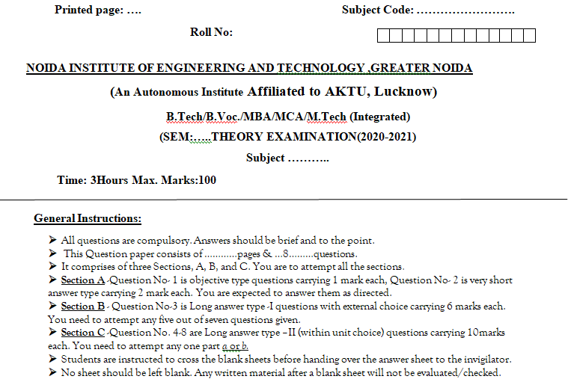
End Semester Question Paper Template

Slide 18

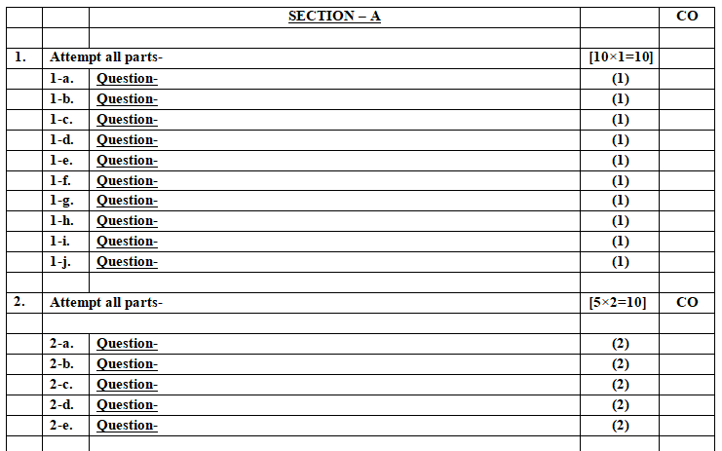
End Semester Question Paper Template

Slide 19

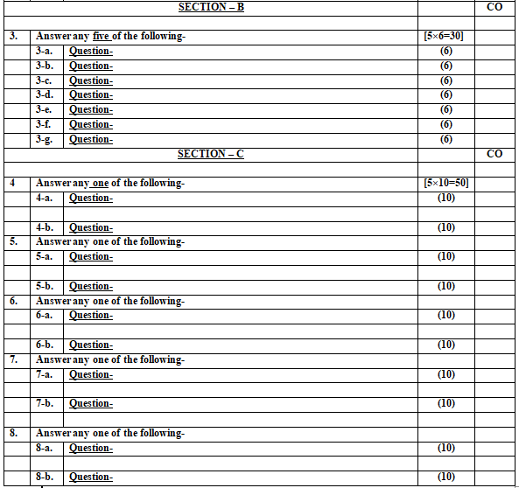
End Semester Question Paper Template

Slide 20

Prerequisite and Recap
Pre-requisites: Understanding of Basics of marketing concepts and social media platforms

Slide 21

Introduction of the subject
The course is designed to make learner conversant with Digital Marketing and proficient in Social Media tools and techniques starting from the fundamentals of digital marketing.
Social media websites and applications allow users to create and exchange user-generated content where people talk, share information, participate and network through technologies such as blogs and social networking sites.
Within the last decade, social media has become one of the most powerful sources for news updates, online collaboration, networking, viral marketing and entertainment.
https://www.youtube.com/watch?v=Xuq6_udbeH0&list=PLi3oNa09iwJRByiNwEJNaZ3XVKcveovzk
https://www.youtube.com/watch?v=X-pCbWwu50k

Slide 22
Unit Contents
Understanding the relationship between content and branding and its impact on sales. (CO3)
Search engine marketing, overview of search engine optimization. (SEO) (CO3)
Mobile marketing, video marketing, and social-media marketing. (CO3)
Marketing Gamification. (CO3)
marketing analytic tools to segment, target and position. (CO3)

Slide 23

Objectives of the Unit
To make the students understand the concept of Search engine marketing.
To explain the different types of Online marketing: Mobile, Video and social media marketing.
To make students understand SEOs ,Market gamification and marketing analytics tool to segment, target and position.

Slide 24

Noida Institute of Engineering and Technology, Greater Noida
(Unit –III) Topic 1
Understanding the relationship between content and branding and its impact on sales

Slide 25

Session Objectives
1. To develop a general understanding on Digital Marketing among the students.
2. To help students gain insights as to why digital marketing is gaining so much importance .
3. To enable students understand the shift from traditional to digital marketing.

Slide 26
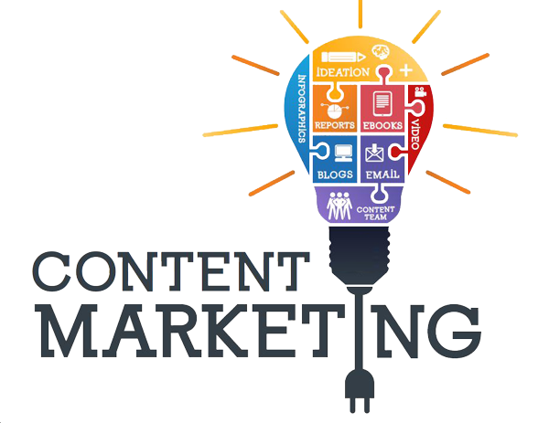
Content Marketing (CO3)

Slide 27

Content Marketing (CO3)
In layman terms, this means that content marketing uses pieces of content, such as blogs, eBooks, newsletters, and videos, to deliver information across all stages of the marketing funnel.

Slide 28

Content Marketing (CO3)
Content marketing is a strategy to attract, engage, and retain an audience by creating and sharing relevant articles, videos, podcasts, and other media. This approach establishes expertise, promotes brand awareness, and keeps your business top of mind when it’s time to buy what you sell.
Notes:
Through this, marketers educate their audience in the hopes of future conversions. Content marketing, like SEO, is a long play and requires a developed strategy to get the most out of your pieces.

Slide 29
The Impact of Content Marketing on Sales (CO3)
Builds Trust
Attracts More People
Keeps People Engaged
Educates Your Audience
Improves Customer Loyalty
Notes:
Builds Trust: When you create valuable and helpful content (like blogs, videos, or how-to guides), your audience starts to trust you. They see you as an expert in your field, which makes them more likely to buy from you.
Attracts More People: High-quality content helps you show up in search engines like Google. If people find your content useful, they’re more likely to visit your website and become potential customers.
Keeps People Engaged: By regularly posting content, you keep your audience interested in your brand. This helps you stay top of mind when they’re ready to make a purchase.
Educates Your Audience: Content marketing can teach your audience about your products or services. When they understand the benefits, they’re more likely to make a purchase.
Supports Social Proof: Good content, especially customer stories or case studies, shows potential buyers that other people trust your brand. This makes new customers feel more confident about buying from you.
Improves Customer Loyalty: When you provide valuable content, customers feel more connected to your brand. This can lead to repeat business and even word-of-mouth referrals.

Slide 30
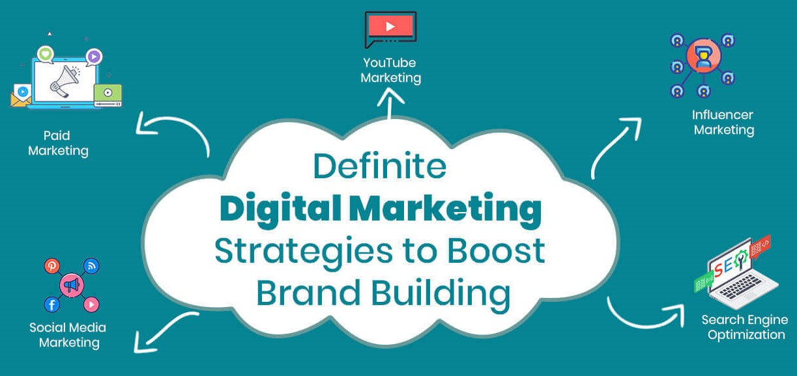
Ways to promote brand via Digital marketing (CO3)
Social Media
Content Marketing
Email Marketing
Search Engine Optimization
Paid Ads
Influencer Marketing
Online Reviews and Testimonials
Contests and Giveaways
Notes:
Social Media: Use platforms like Instagram, Facebook, TikTok, or Twitter to post about your products or services. Share updates, behind-the-scenes content, and engage with your audience through comments or messages.
Content Marketing: Create useful content like blogs, videos, or infographics. Share valuable information that helps your audience, which can also drive more traffic to your website.
Email Marketing: Send out newsletters or promotional emails to your customers. Make sure the content is personalized, relevant, and offers something of value, like discounts or useful tips.
Search Engine Optimization (SEO): Optimize your website with the right keywords so that people can find you when they search for things related to your business on Google.
Paid Ads: You can use platforms like Google Ads or Facebook Ads to run paid campaigns that target your ideal audience. This helps you reach more people quickly.
Influencer Marketing: Partner with influencers who have a large following in your niche. They can promote your brand to their audience in a more personal and trusted way.
Affiliate Marketing: Collaborate with affiliates who will promote your product for a commission. This helps increase sales and brand awareness without too much risk.
Online Reviews and Testimonials: Encourage customers to leave reviews or share their experiences with your product. Positive reviews can help build trust and attract more customers.
Contests and Giveaways: Run a contest or giveaway on your website or social media. This can create excitement, increase engagement, and help attract new followers.
Retargeting Ads: Show ads to people who visited your website but didn't buy anything. This helps remind them of your product and bring them back.

Slide 31

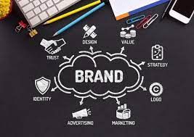
The Impact of Content Marketing on Sales (CO3)
Builds Trust and Credibility
Drives Traffic and Lead Generation
Supports Social Proof and Customer Testimonials
Improves Customer Retention
Enhances the Buying Decision Process
Supports Long-term Growth
Personalizes the Customer Experience
Cost-Effective Sales Tool
Notes:
Builds Trust and Credibility
Content marketing helps to build trust with your audience by providing valuable, informative, and relevant content. When customers trust your brand, they are more likely to make a purchase. For example, educational blog posts, how-to guides, or case studies demonstrate your expertise and establish credibility.
Drives Traffic and Lead Generation
Well-executed content marketing can attract traffic to your website and increase brand awareness. By optimizing content for search engines (SEO), businesses can ensure they reach a wider audience.
Supports Social Proof and Customer Testimonials
Content marketing can include testimonials, user-generated content, reviews, and case studies. These pieces serve as social proof that your product or service is effective, further persuading potential customers to make a purchase.
Improves Customer Retention
Once customers make a purchase, content marketing can help retain them by keeping them engaged. Providing additional valuable content post-purchase (like product tutorials, maintenance tips, or relevant updates) can turn a one-time buyer into a loyal customer.
Enhances the Buying Decision Process
Quality content allows potential customers to make informed decisions. Blog posts, product comparisons, and detailed reviews help buyers evaluate the best options for their needs. By providing clear and engaging content, you can position your product or service as the ideal choice.
Supports Long-term Growth
Content marketing is not a short-term tactic—it provides long-lasting value. Once content is created and optimized, it can continue to generate traffic, leads, and conversions for months or even years.
Personalizes the Customer Experience
Content marketing helps tailor the customer experience by providing the right content at the right stage of the buyer’s journey. Personalized content that speaks directly to a customer’s pain points and needs leads to higher engagement and a higher likelihood of conversion.

Slide 32

Daily Quiz
Content marketing is about sharing information that has real value to your target audience and educate your potential customers. (True/False)
Explain the impact of Content on Sales.
Content on the web includes _______.
The goal of ________ is to increase the demand for a product or service through useful information.

Slide 33
Noida Institute of Engineering and Technology, Greater Noida
(Unit –III) Topic 2
Search Marketing- SEM and SEO

Slide 34
Recap
Content marketing uses pieces of content, such as blogs, eBooks, newsletters, and videos, to deliver information across all stages of the marketing funnel.
The marketers educate their audience in the hopes of future conversions.

Slide 35
Session Objective
Students will understand the relevance of search engine marketing.
Students will get basic knowledge of SEO and PPC.

Slide 36
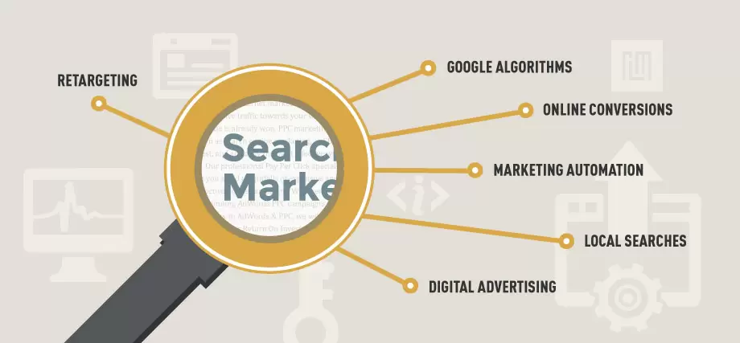
Search Marketing(CO3)

Slide 37
Search Marketing(CO3)
Search Marketing is a tactic used to gain online presence and traffic via paid and unpaid strategies on search engines such as Google, Bing, and Yahoo.
Visualize the last time you searched for something whether that be on Google, Yahoo, or Bing.
Search marketing is promoting your business by getting your website to appear in search engine results, like Google. It’s about ensuring that people can easily find you when they search for things related to your product or service.

Slide 38

List of the best search engines (CO3)
Google
Microsoft Bing
Yahoo
Baidu
Yandex
DuckDuckGo
Ask.com
Ecosia
Aol.com
Internet Archive

Slide 39

Purpose of Search Marketing(CO3)
Purpose of Search Marketing
Acquire New Customers
Retain Old Customers
Create Awareness by means of Content marketing
Engage the customers to make 1st purchase by offering freebies

Slide 40

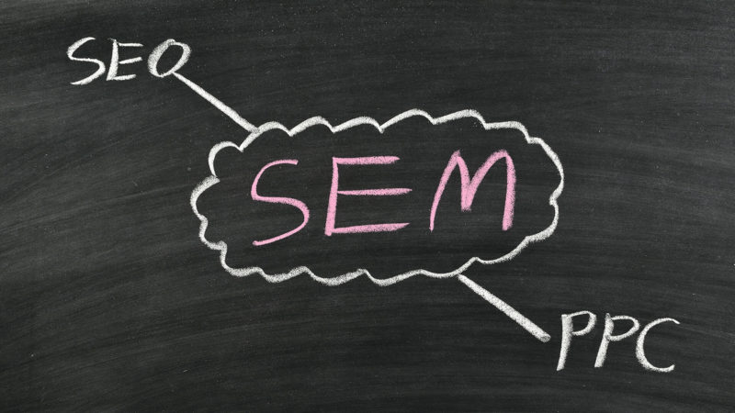
Types of Search Marketing(CO3)

Slide 41

Types of Search Marketing(CO3)
SEO (Search Engine Optimization): Gaining search engine listings via unpaid tactics.
PPC (Pay-per-click or paid advertising): Gaining search engine listings via paid tactics.
SEM - An approach that uses paid methods to appear in search results.

Slide 42
Overview of search engine optimization (SEO)(CO3)
SEO stands for Search Engine Optimization.
Search Engine Optimization (SEO) is the process of improving your website so that it appears higher in search engine results (like Google) when people look for things related to your business.
Notes:
SEO is a subset of search engine marketing. SEO is also referred as SEO copyrighting, because most of the techniques that are used to promote sites in search engines, deal with text.

Slide 43
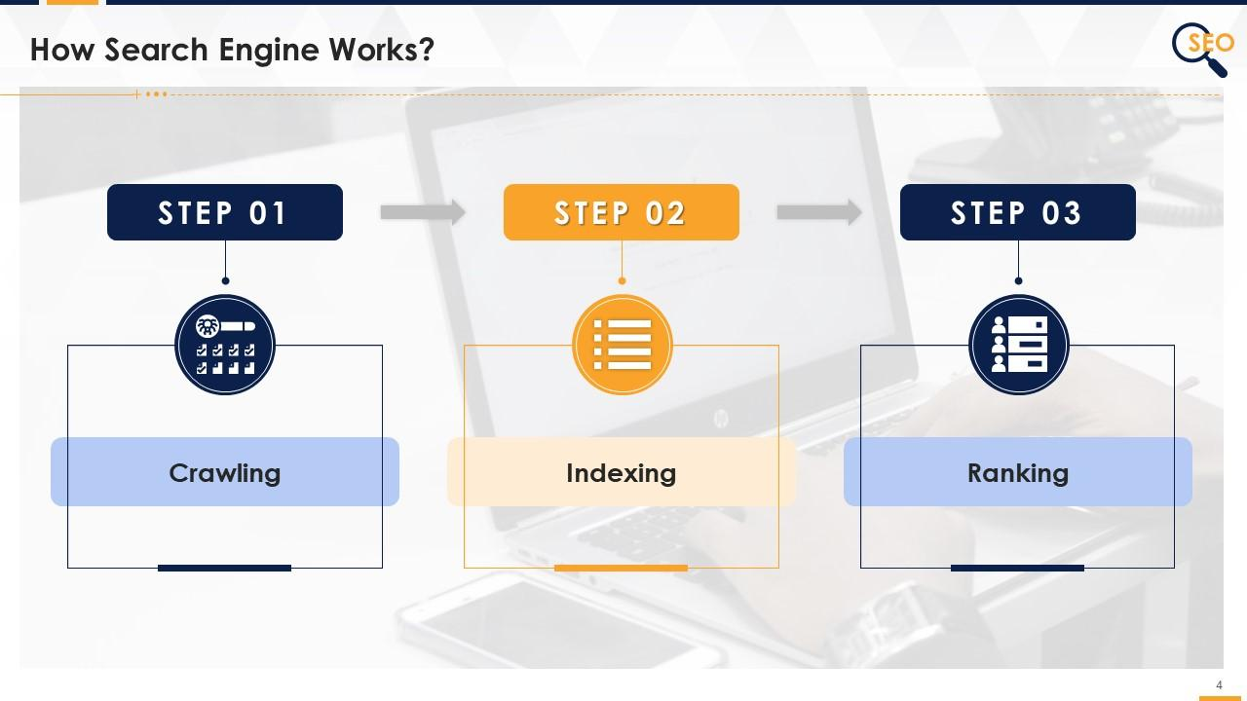
Search engine Optimization (CO3)
Notes:
Crawling is when a search engine sends a robot (called a "crawler") to visit websites. The robot looks at the pages, reads the content, and collects information to help the search engine know what the website is about. When you post a new picture on Instagram, a search engine crawler visits your page, looks at the picture, and remembers it. Later, when someone searches for similar pictures, it shows your post in the results.
Indexing is when a search engine takes all the information it has crawled from websites and stores it in a big digital library. This helps the search engine quickly find and show the right pages when someone searches for something.
Ranking is how a search engine decides which websites to show first when someone searches for something. The better a website is, the higher it appears in the search results.
It’s like putting books in a library under the right categories so that when you need one, it’s easy to find.

Slide 44

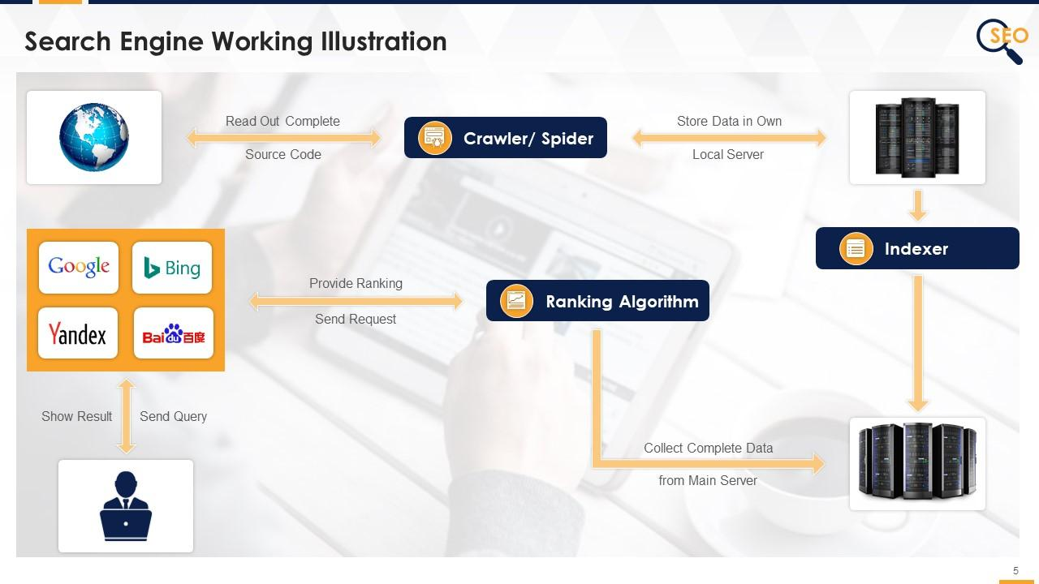
Search engine Optimization (CO3)

Slide 45

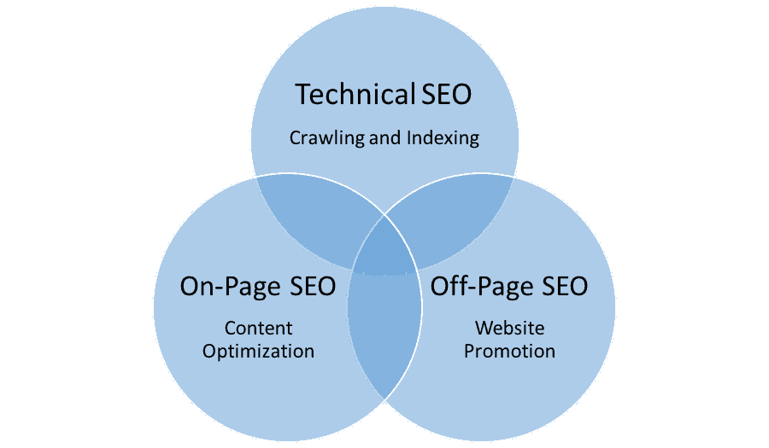
Types of SEO(CO3)

Slide 46

On-Page SEO(CO3)
On-page SEO refers to the things you can do directly on your website to help it rank higher in search engines like Google. This includes things like using the right keywords in your content, making sure your website is easy to navigate, optimizing images, and having a clear title and meta description. It's all about improving your website so search engines understand it better and show it to more people.
Using the right words (keywords) people are searching for.
Creating a clear title for your page.
Writing a short, catchy description of what your page is about.
Making sure your content is helpful and easy to read.

Slide 47
Off-Page SEO(CO3)
Off-Page SEO refers to actions taken outside of your website to improve its ranking on search engines. This includes getting other websites to link to your site (backlinks), sharing your content on social media, and building your online reputation. The idea is to show search engines that your website is trustworthy and popular, which can help it rank higher in search results.
Notes:
You run a bakery website.
Backlink: A local food blog mentions your bakery and links to your website.
Social Media: People share photos of your cupcakes on Instagram.
Review: A customer leaves a good review about your bakery on Google.

Slide 48

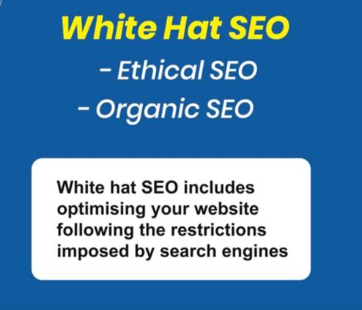
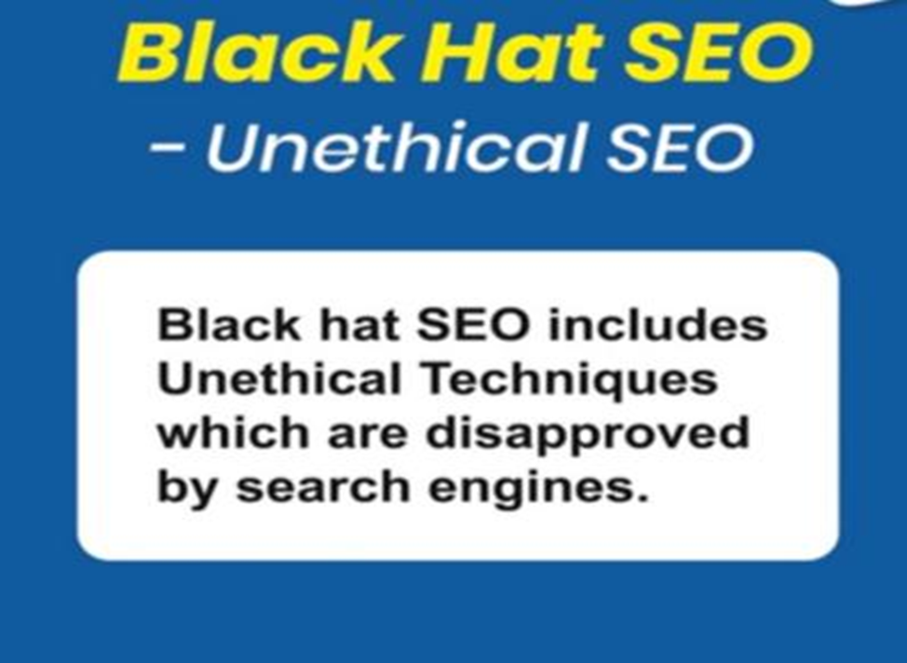
Types of Technical SEO(CO3)

Slide 49
White Hat SEO
White Hat SEO refers to using ethical and approved methods to improve your website’s ranking in search engines. This includes things like creating high-quality content, using relevant keywords, and building natural backlinks. The goal is to provide a good user experience and follow search engine rules, rather than trying to trick or cheat the system. It’s the “good” and safe way to do SEO.
Notes:
You write helpful blog posts about healthy recipes and use keywords that people search for. You also make sure your website is easy to navigate.
This is White Hat SEO because you're following the rules and focusing on giving value to your visitors.

Slide 50

Black Hat SEO
Black Hat SEO refers to using unethical or dishonest methods to try to get a website to rank higher in search engines. These methods often break search engine rules and can lead to penalties or being banned from search results. It’s like cheating to get quick results instead of focusing on creating value for users.
Notes:
A website uses tricks like hiding text or using fake backlinks to try to rank higher quickly.
This is Black Hat SEO because it's dishonest and goes against search engine rules.

Slide 51

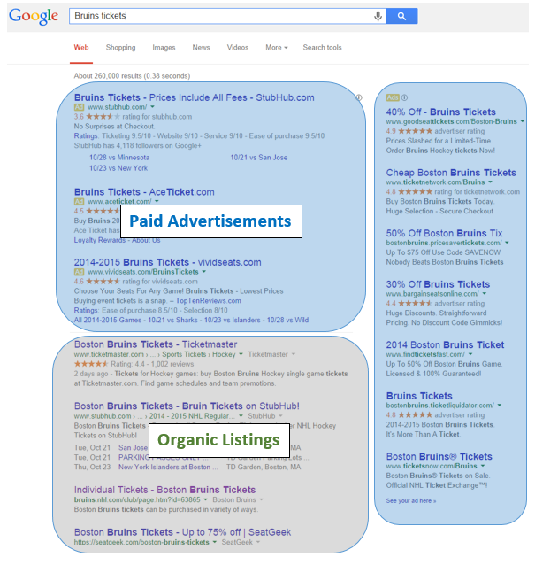
Search Engine Optimization (CO3)

Slide 52

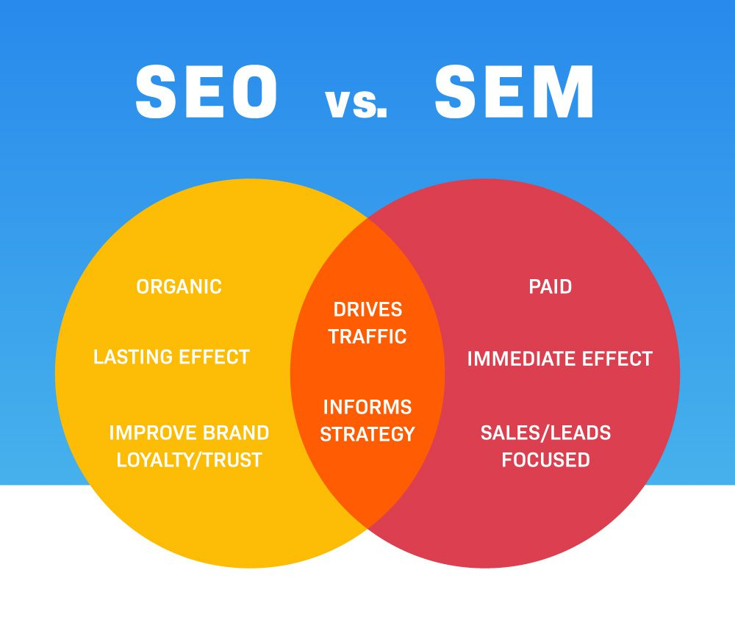
Search Engine Optimization Vs Search Engine Marketing(CO3)

Slide 53

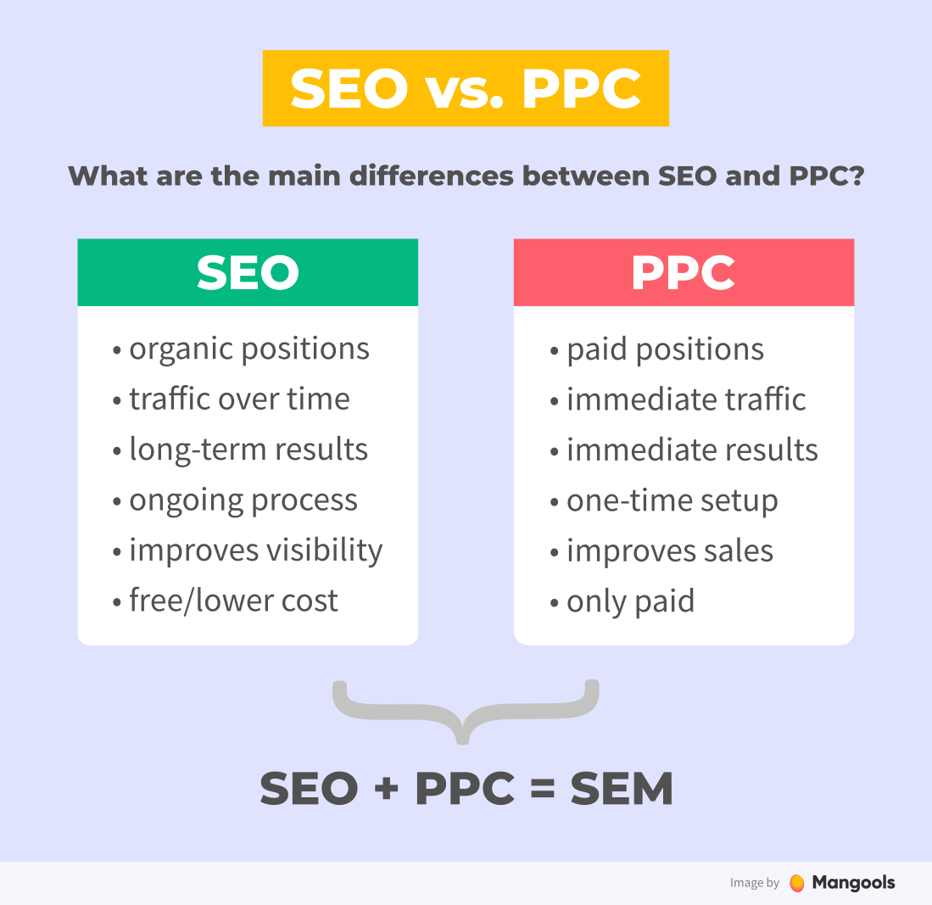
Search Engine Optimization & Search Engine Marketing(CO3)

Slide 54
Daily Quiz
2 types of search marketing are: ________ & _______.
Search Marketing is always paid. (True/False)
SEO stands for ________.
Unpaid advertisements are called _______ listings.
SERP stands for Search engine review page. (True/ False)

Slide 55
Noida Institute of Engineering and Technology, Greater Noida
(Unit –III) Topic 3
Social Media Marketing, Mobile Marketing and Video Marketing

Slide 56

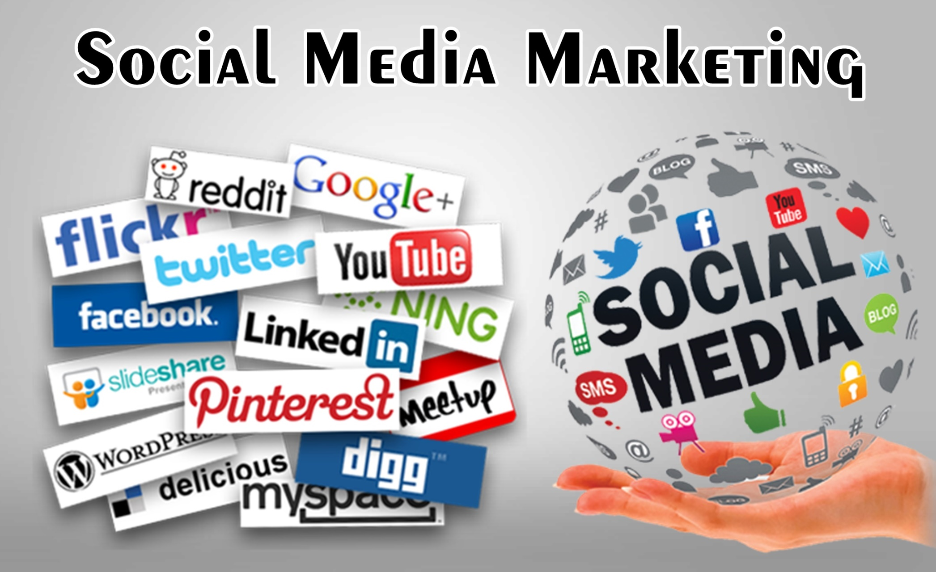
Social Media Marketing(CO3)
Notes:
Social media marketing is the practice of using social media platforms and tools to promote a business and connect with existing and potential customers.

Slide 57

Social Media Marketing(CO3)
Social Media Marketing (SMM) is the practice of using social media platforms like Facebook, Instagram, Twitter, and LinkedIn to promote a product, service, or brand. It involves creating posts, ads, and content to engage with an audience, build a community, and increase brand awareness or sales. Essentially, it's about reaching and connecting with people online through social networks to achieve business goals.

Slide 58

Fundamentals of Social Media Marketing(CO3)
Know your audience
Create engaging content
Consistency
Use hashtags
Interact with followers
Track results
Notes:
Know your audience: Understand who you're trying to reach (age, interests, location, etc.).
Create engaging content: Share posts, images, videos, or stories that will interest your audience.
Consistency: Post regularly so your followers stay engaged
.Use hashtags: Help people discover your posts by using relevant hashtags.
Interact with followers: Reply to comments, messages, and engage with your audience.
Track results: See what works and what doesn’t, then adjust your strategy accordingly.

Slide 59

Goals of Social Media Marketing
(CO3)
Increase brand awareness
Engage with your audience
Drive website traffic
Generate leads or sales
Improve customer loyalty
Notes:
Increase brand awareness: Make more people know about your brand.
Engage with your audience: Build relationships with followers through comments, likes, and shares.
Drive website traffic: Get more people to visit your website from social media.
Generate leads or sales: Encourage people to buy your products or services.
Improve customer loyalty: Keep your customers happy and coming back.

Slide 60
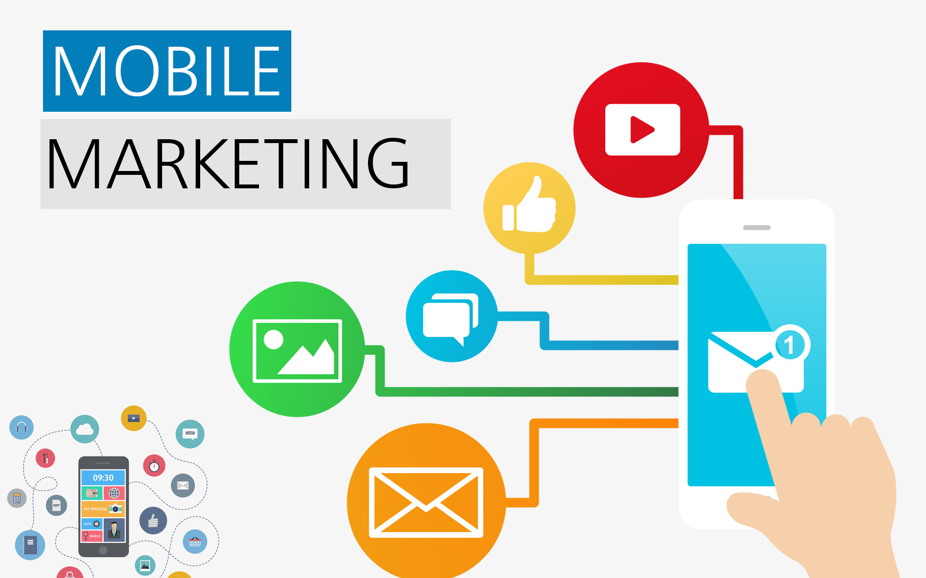
Mobile Marketing(CO3)
Notes:
Mobile marketing is any advertising activity that promotes products and services via mobile devices, such as tablets and smartphones.

Slide 61

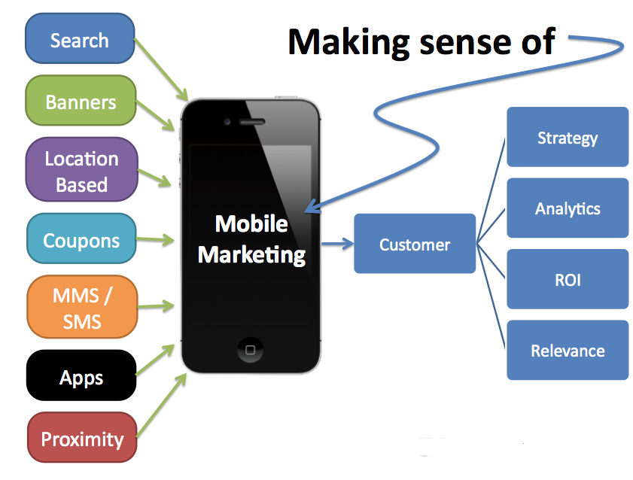
Mobile Marketing(CO3)
Notes:
Mobile is disrupting the way people engage with brands. Everything that can be done on a desktop computer is now available on a mobile device.

Slide 62

Benefits of Mobile Marketing(CO3)
Reach people anytime, anywhere
Personalized messages
Instant communication
Higher engagement
Easy to track
Notes:
Reach people anytime, anywhere: People carry their phones everywhere, so you can reach them at any time.
Personalized messages: You can send tailored messages based on their interests or location.
Instant communication: Mobile marketing allows quick, direct communication with your audience.
Higher engagement: Mobile ads often get more attention because people spend a lot of time on their phones.
Easy to track: You can easily measure how well your mobile ads are doing, like how many people clicked on them.

Slide 63
Type of Mobile Marketing(CO3)
SMS Marketing
Mobile App Marketing
In-App Advertising
Mobile Website Marketing
Push Notifications
Social Media Marketing
Notes:
SMS Marketing: Sending text messages with offers, updates, or reminders to customers.
Mobile App Marketing: Promoting your app through ads or notifications to encourage downloads or usage.
In-App Advertising: Displaying ads inside other apps that users are already using.
Mobile Website Marketing: Optimizing your website for mobile devices so customers can easily browse and shop.
Push Notifications: Sending brief messages directly to users' mobile screens from apps or websites they’ve installed.
Social Media Marketing: Using platforms like Instagram, Facebook, or Twitter to connect with customers through mobile devices.

Slide 64

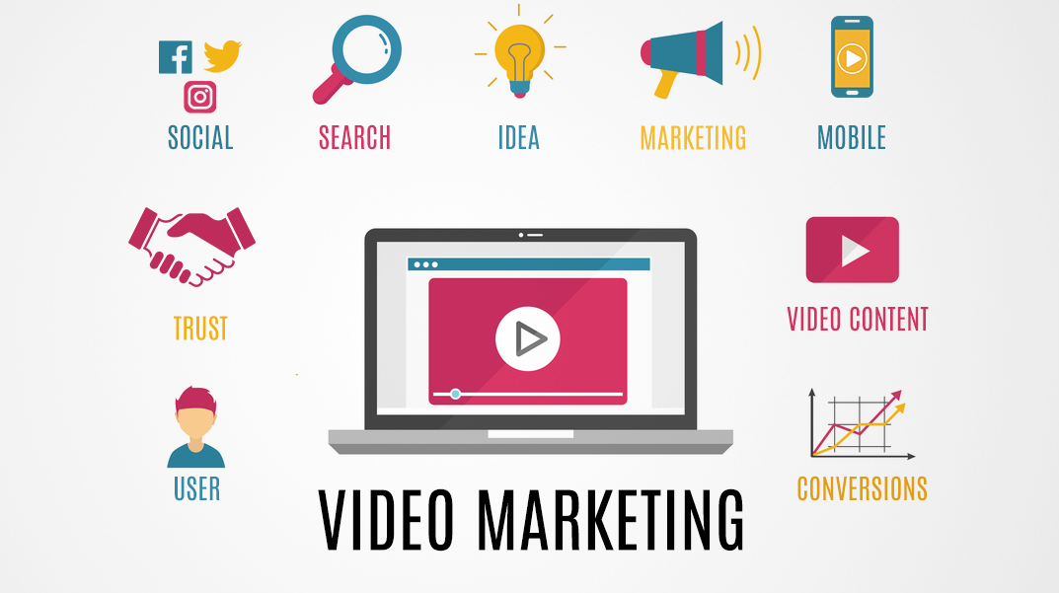
Video marketing(CO3)
Notes:
Video marketing is using video to market your product, increase engagement, and reach an audience more amenable to video than to text.

Slide 65
Video marketing(CO3)
Video marketing refers to the use of video to market or promote your brand or offering on digital channels.
In simple terms, when you use video to market your brand, product or service, engage on social media channels, educate your prospective and current customers, and interact with them, you’re said to be using video marketing.
Video marketing can be used for everything from building customer rapport, to promoting your brand, services or products.
Notes:
Video marketing, a forward-facing marketing strategy that integrates engaging video into your marketing campaigns.

Slide 66
Video marketing(CO3)
To develop your video marketing strategy, you’ll want to:
Set your goals
Know your audience
Choose video types
Pick the right platforms
Create valuable content
Optimize for search
Track and measure success
Notes:
Set your goals: Decide what you want to achieve with your videos (e.g., increase sales, build brand awareness, educate customers).
Know your audience: Understand who you want to reach with your videos (age, interests, problems to solve).
Choose video types: Decide what kind of videos you'll create (product demos, tutorials, customer stories, etc.).
Pick the right platforms: Choose where you'll post your videos (YouTube, Facebook, Instagram, etc.) based on where your audience spends time.
Create valuable content: Make videos that are interesting, helpful, and engaging for your viewers.
Optimize for search: Use relevant titles, tags, and descriptions to help people find your videos.
Track and measure success: See how well your videos are doing (views, likes, shares, comments) and adjust your strategy as needed.

Slide 67
Benefits of Video Marketing(CO3)
Better Engagement:
Increased Brand Awareness
Boosts Sales
Improves Trust
Easy to Share
Better SEO
Notes:
Better Engagement: People are more likely to watch and interact with videos than other types of content like text or images.
Increased Brand Awareness: Videos help more people discover your brand and remember it.
Boosts Sales: Videos can show off your product or service in action, making it more likely for people to buy.
Improves Trust: Seeing a product or service in a video builds trust, as customers can see how it works and how it benefits them.
Easy to Share: Videos are often shared on social media, helping spread the word about your business.
Better SEO: Videos can help improve your search engine rankings, making it easier for people to find your business online.

Slide 68
Challenges of Video Marketing (CO3)
High Production Costs
Time-Consuming
Requires Skills
Keeping Attention
Platform Limitations
Measuring Success
Notes:
High Production Costs: Creating quality videos can be expensive, especially if you need professional equipment or actors.
Time-Consuming: Planning, filming, editing, and promoting videos takes a lot of time and effort.
Requires Skills: You need good video editing and storytelling skills to make your videos interesting and professional-looking.
Keeping Attention: It can be hard to keep viewers' attention, especially with so many videos online. Your video needs to be engaging from start to finish.
Platform Limitations: Different platforms have different rules and formats for videos, so you need to adjust your videos accordingly.
Measuring Success: It can sometimes be difficult to track exactly how well your video is performing in terms of sales or engagement.

Slide 69
Types Of Video Content (CO3)
Product Demo
Interviews
Testimonials
Event Videos
Explainer Videos
.

Slide 70
Types Of Video Content (CO3)
Vlog
Presentations & Talks
Tutorials
Behind The Scenes
Live Videos

Slide 71
Daily Quiz
The most common form of Mobile marketing is _____ marketing.
2. Which of the following is the most common delivery channel in terms of mobile marketing?
Graphic
Text
Voice call
Search engine marketing
________ marketing refers to the use of video to market or promote your brand or offering on digital channels.
Viral
Native
Mobile
Video

Slide 72
Daily Quiz
_________marketing is the use of social media platforms and websites to promote a product or service.
SMM stands for ______.
Name the different social media networks.
________ marketing is a sales technique that involves organic or word-of-mouth information about a product or service to spread at an ever-increasing rate.
________ marketing is the act of sending promotional messages to people in mass quantities

Slide 73
Noida Institute of Engineering and Technology, Greater Noida
(Unit –III) Topic 4
Marketing Gamification

Slide 74
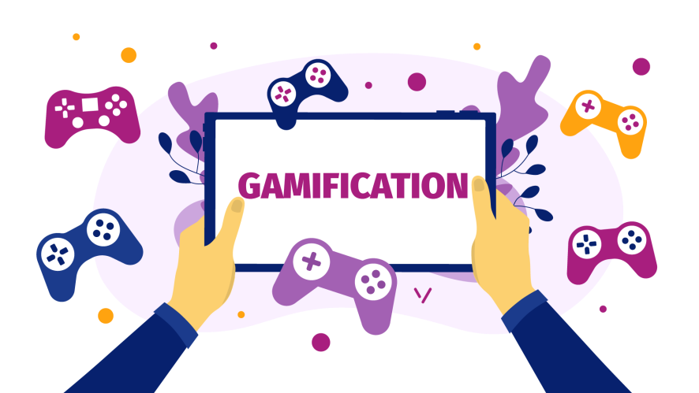
Marketing Gamification
MARKETING

Slide 75
Gamification Marketing
Gamification marketing is an enhanced marketing technique that borrows design elements from games to attract and retain customers.
In gamification marketing, consumers are driven to perform an action because it offers elements of competition or reward.

Slide 76
Benefits of Gamification for the Marketing Strategy(CO3)
1. Gamification increases
average website session time;
average time spent reading an email;
audience engagement;
Increase social sharing.
2. It makes the user experience more enjoyable and results in better satisfaction.
3. In gamification marketing, consumers are driven to perform an action because it offers elements of competition or reward

Slide 77
Benefits of Gamification for the Marketing Strategy(CO3)
3. Compared to other marketing tools, email gamification doesn’t require complex solutions or algorithms.
4. A simple quiz or a challenge to find a hidden link can be implemented within a basic email template.
5. It helps collect customer data.
Like Gamification uses different options to encourage people to provide personal info (contacts, product preferences) in exchange for bonuses (points, prizes, starts, achievements, badges, % off, etc.).

Slide 78
Main Principles of Gamification (CO3)
1. Achievable task.
2. Clear goal.
3. Engaging design.
4. Fun process.
5. Reward.

Slide 79
On-Site Gamification Examples (CO3)
Wheel of Fortune
Wheel of Fortune is an entertaining element that gives visitors a chance to receive a small gift, and the brand – collect the customer data (name, email address, sometimes phone number) and encouraging the first purchase at the same time.

Slide 80
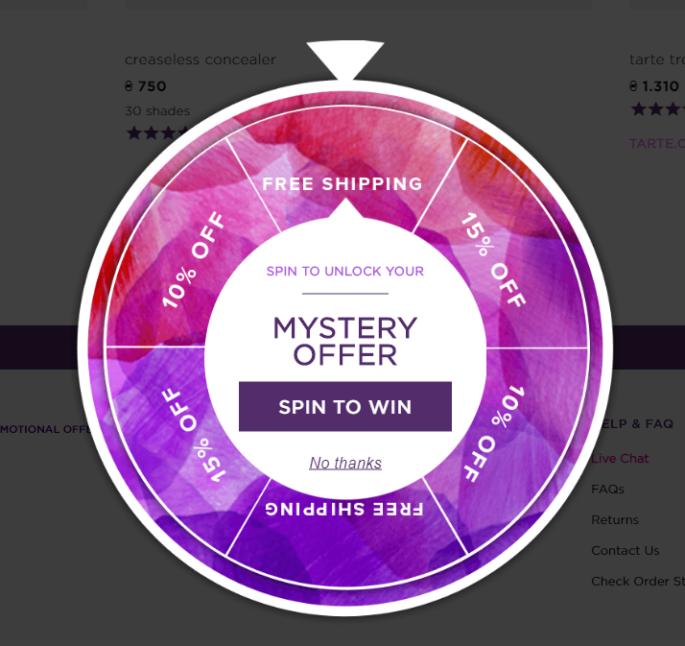
On-Site Gamification Examples (CO3)

Slide 81
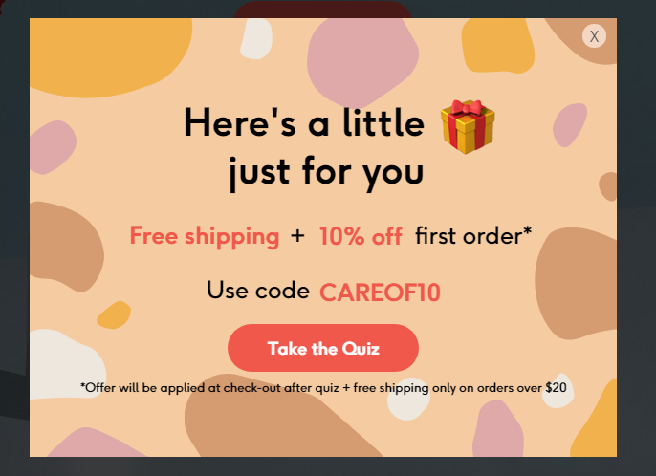
On-Site Gamification Examples (CO3)
A quiz is another gamification element that helps get contacts and get more information on customer’s preferences.

Slide 82
On-Site Gamification Examples (CO3)
Badges
Badge system is a great way to build customer loyalty: a badge can be a good reward for using the product within a long period, making it through different stages.
It’s always exciting to unlock new levels and collect new trophies, so customers like this way of interaction.
Notes:
The same principle lies behind bonuses, membership rewards, progress-based points and certificates, etc. Offering prizes for step-by-step completion of a particular process helps retain customers and build a committed audience.

Slide 83
On-Site Gamification Examples (CO3)
Goibibo – Gamification for Travel
Goibibo had gamified their app to capitalize on the current trend: Indian Premier League.
The app introduced goCashFest, where users can earn GoCash when time the Mumbai Indians play.
By using the app while the team plays, users win GoCash for each 4s, 6s, 50, 100, wickets and wins during the match.
This goCash is valid until the next Mumbai Indians match and can be used to make bookings on Goibibo.

Slide 84
On-Site Gamification Examples (CO3)
Byju’s – Gamification for Education
Byju’s uses gamification by allowing students to play games, earn reward points, and challenge each other through different quizzes and competitions.
Competing with each other motivates students to work for better results.
This sort of gamification results in a win-win situation for the app as well as its users.

Slide 85
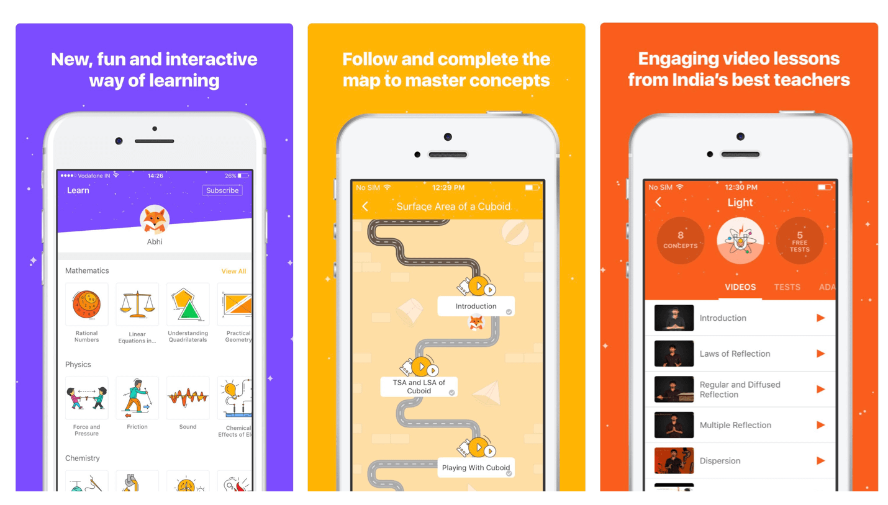
On-Site Gamification Examples (CO3)

Slide 86
On-Site Gamification Examples (CO3)
Starbucks – Gamification for Loyalty Programs
The Starbucks app features a loyalty system that rewards users with stars for each order placed, which can then be redeemed for free food and drinks.
https://www.youtube.com/watch?v=gfFgga9XY7k&t=28s

Slide 87
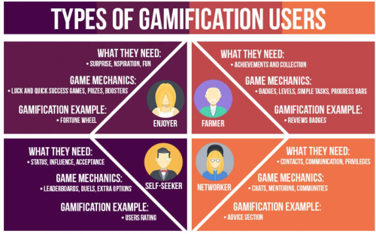
Marketing Gamification and Apps(CO3)

Slide 88
Gamification Marketing benefits (CO3)
Games allow companies to attract fans in social media by also constituting an important element of competition.
Games allow education and integration of members of group or branch.
Games can provide consumers with a positive fun filled and entertaining experience.
Games permit companies to simulate real life situations that customers identify with easily in such a way that target group gets more engaged.

Slide 89
Daily Quiz
Gamification makes the user experience more enjoyable. (True/ False)
Name any 2 types of Gamification users.
______ is defined as a set of all dynamic and entertaining solutions and elements integrated into website, app or email campaigns.
_____ is an example of Marketing gamification.
________ allow companies to attract fans in social media by also constituting an important element of competition.

Slide 90
Noida Institute of Engineering and Technology, Greater Noida
(Unit –III) Topic 5
Marketing analytic tools to segment, target and position.

Slide 91
Marketing analytic tools to segment, target and position
When used correctly, analytics can provide you with an immense pool of information, and can really help you to pinpoint effective marketing strategies and target your market correctly.
Marketing Analytics tools
Target Audience
Google Analytics Dashboard Know where Visitors Comes From
Adwords Conversion Tracking

Slide 92
Marketing analytic tools to segment, target and position
Target Audience
Google Analytics can really provide you with a myriad of information ,as long as you know where to find it and how to read the data.
Website metrics will help you review user traffic and define all types of information about your visitors. This, in turn, will give you the opportunity to see exactly where your visitors are coming from ,and even why they are visiting your content.
Analytics should become a key part of your business, objectives as they can be used to help you develop all types of areas of your business: sales (ecommerce), lead generation, content publishing, online information , and branding.
Analytics can easily be used as a way to segment your traffic or your users and define you r target audience, which will then help you identify areas where you can target new readers.

Slide 93
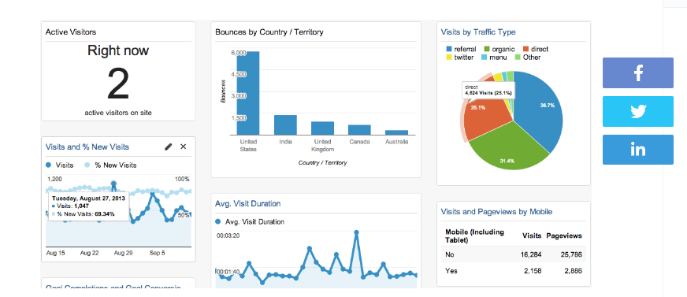
Marketing analytic tools to segment, target and position
Google Analytics

Slide 94
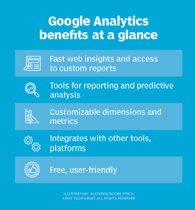
Marketing analytic tools to segment, target and position
Google Analytics

Slide 95
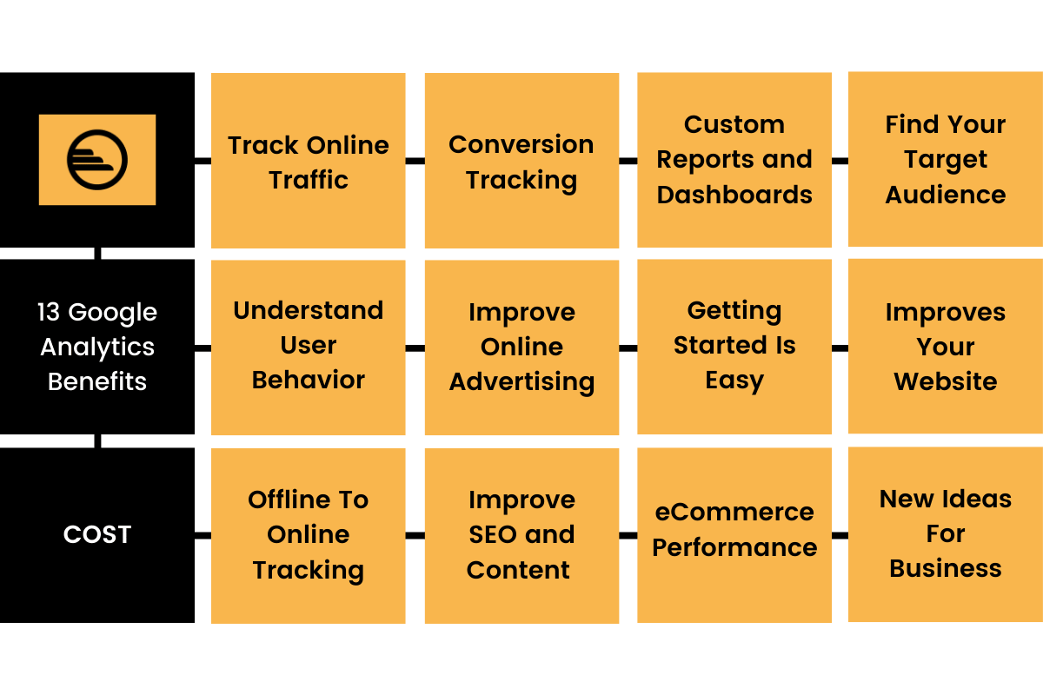
Marketing analytic tools to segment, target and position
Google Analytics and it’s benefits

Slide 96
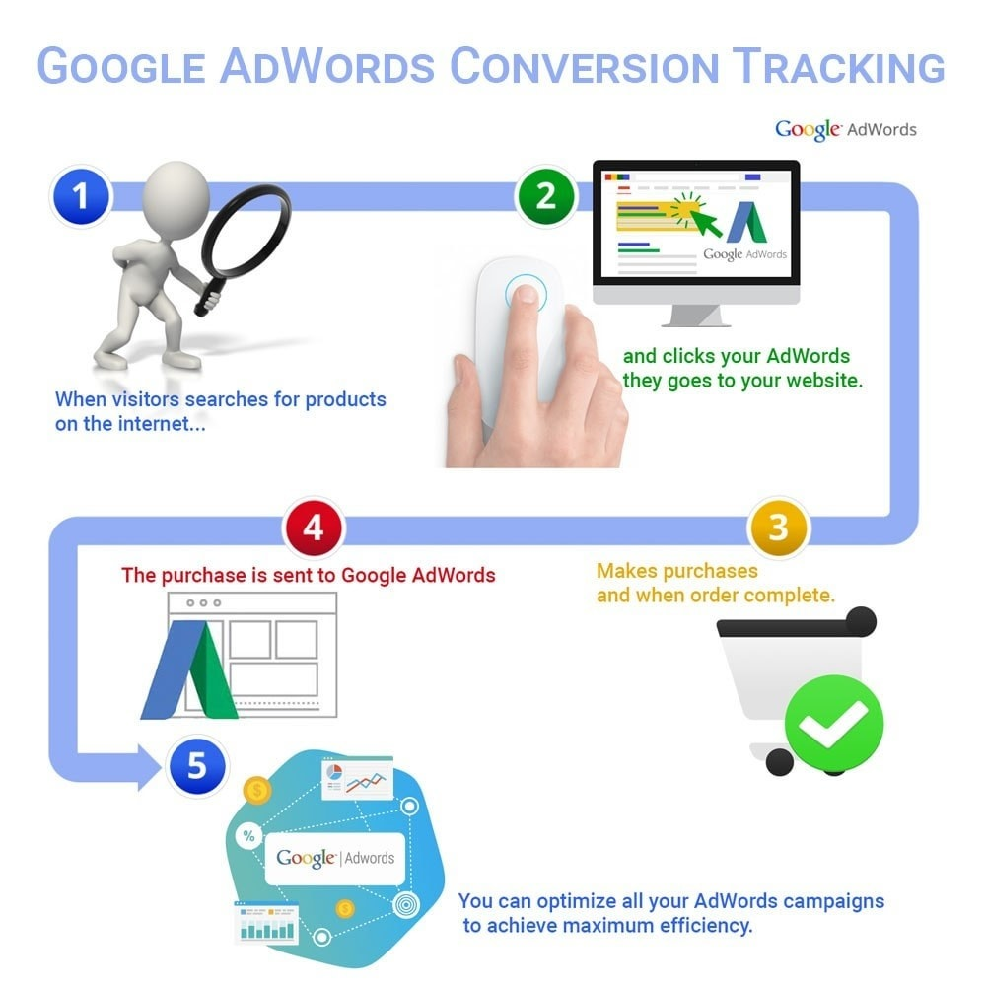
Marketing analytic tools to segment, target and position
Adwords Conversion Tracking

Slide 97
Google Analytics, AdWords, and other on line analytics and advertising tools all contain a huge pool of information that will help you create not only your own brand, but also develop and grow your target audience and pin point advertising strategies that work for you. All of this information can help you grow your business and there are many extensive guides available on line for free. You can't go wrong with using all of this available data to your advantage!

Slide 98
Topic Links and Online Courses details
https://www.youtube.com/watch?v=0R_3iarc8IA
https://www.youtube.com/watch?v=kAjtioDwM58
https://www.youtube.com/watch?v=gfFgga9XY7k&t=31s
https://academy.hubspot.com/courses/content-marketing
https://www.coursera.org/learn/content-marketing

Slide 99
Assignment
Q1.State the importance of content in Online marketing?
Q2.State the two major types of search marketing techniques ?
Q3. Write short notes on : i) Mobile marketing ii) Viral marketing
Q4.Discuss the different types of Gamification strategies used in digital marketing with examples.

Slide 100
MCQs
Q1.________ is the process of marketing accomplished or facilitated via the use of internet technologies (e.g. web, email, intranet, extranets).
a) Internet marketing
b) Search marketing
c) e-marketing
d) Mobile marketing
Q2. This form of advert delivered on social platforms and social gaming websites and apps, across all device types is known as:
a) mobile marketing
b) social media advertising
c) internet advertising
d) e-marketing
Q3. A form of marketing communications that uses the internet for the purpose of advertising, aiming to increase website traffic and/or encourage product trial, purchase, and repeat purchase activity is called:
a) Search marketing.
b) E-mail marketing.
c) Internet advertising.
d) Social web marketing.

Slide 101
MCQs
Q4. An advertising model in which advertisers bid on keywords or phrases relevant to their target market, with sponsored/paid search engine listings to drive traffic to a website is called:
a) Search Engine Optimization (SEO).
b) Contextual Advertising.
c) Digital Asset Optimization (DAO).
d) Pay Per Click (PPC).
Q5.____________ is a form of digital marketing that describes the use of the social web and social media (e.g. social networks, online communities, blogs or wikis) or any online collaborative technology for marketing activities, be it sales, public relations, research, distribution or customer service.
a) Pay Per Click (PPC)
b) Digital Asset Optimization (DAO)
c) Social Media Marketing (SMM)
d) Search Engine Optimization (SEO)
Q6. ____________ is the set of practices that enables organizations to communicate and engage interactively with their audiences through any mobile device or network.
a) Mobile marketing
b) Social web marketing.
c) Internet marketing
d) Social media marketing

Slide 102
Glossary
In game advertisement, Crawling, Marketing gamification, Search engines, Search, content
1. ______ Marketing is a tactic used to gain online presence and traffic via paid and unpaid strategies
2. Wheel of fortune is an example of ________.
3. Google, Bing, and Yahoo are examples of _________.
4. _______ marketing uses pieces of content, such as blogs, eBooks, newsletters, and videos, to deliver information
5. ______ refers to all advertisements on mobile devices that pop up when certain games are opened or in progress
6. Process of fetching all the web pages linked to a website is called _______.

Slide 103
University Paper Links
https://www.uptunotes.com/aktu-paper-digital-marketing-mammk04-2018-19/
http://www.aktuonline.com/papers/mba-3-sem-digital-and-social-media-marketing-kmbmk03-2020.pdf
http://www.aktuonline.com/papers/mba-3-sem-digital-marketing-rmbmk03-2020.html
http://www.aktuonline.com/papers/mba-3-sem-digital-marketing-rmbmk-03-2018-19.html

Slide 104
Expected questions for University Exams
Q1.State the impact of content on Sales.
Q2.State the two major types of search marketing techniques ?
Q3.Give any two benefits of using search engine optimization to a marketer.
Q4.Discuss what is Mobile marketing.
Q5.Explain social media marketing ?
Q6. Discuss the relevance of gamification in marketing.
Q7.Explain in detail Marketing analytic tools to used for segmentation, targeting and positioning.
Q8. Explain in detail Video marketing and social media marketing.

Slide 105
Sessional Question paper (Online)
Objective Paper
https://forms.office.com/r/kNi2FiFC0f
Subjective Paper
https://forms.office.com/r/h8K7Auphdm

Slide 106
Sessional Question paper

Slide 107
Sessional Question paper

Slide 108
Sessional Question paper

Slide 109
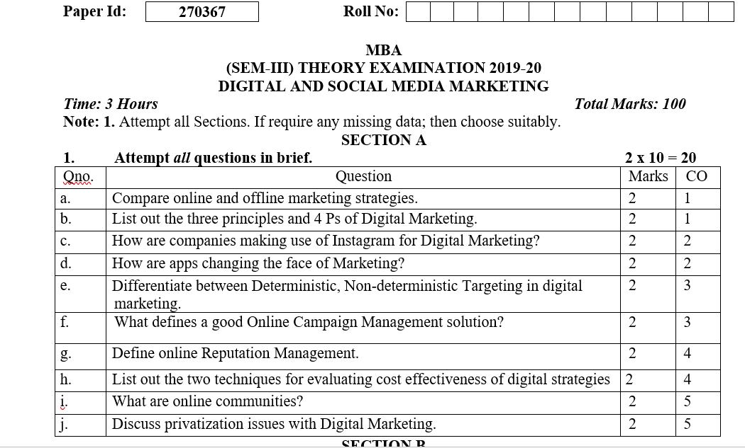
End Semester Question paper

Slide 110
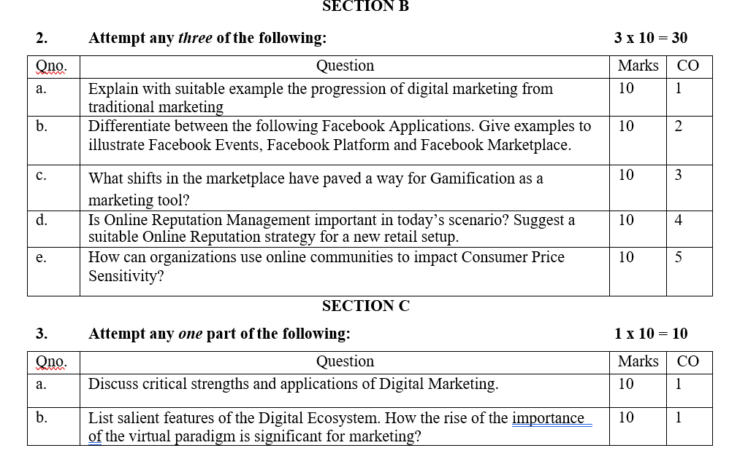
End Semester Question paper

Slide 111
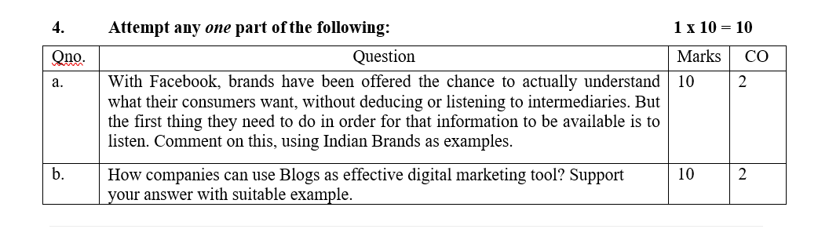
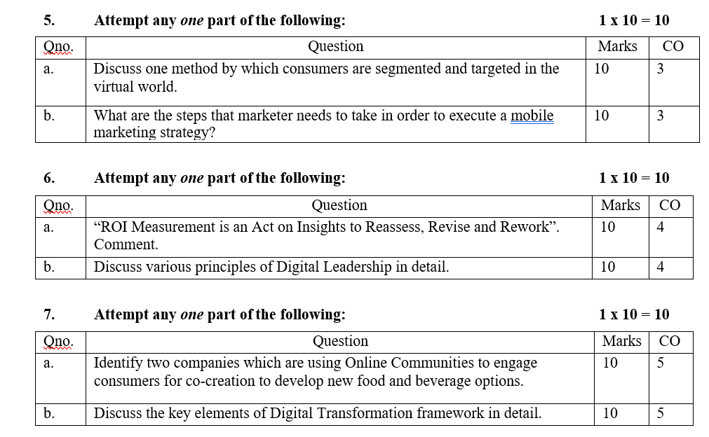
End Semester Question paper

Slide 112
Summary
Search Engine Marketing(SEM) & Search Engine Optimization (SEO) Both are online techniques for increasing a brand or product’s visibility to audiences using search engines to find information.
The future of marketing of gamification and apps marketing is about to enter a more challenging territory. Building on the vast increase in consumer power brought on by the digital age marketing is headed towards being on demand not just always on but also always relevant responsive to the consumer desire for marketing that cuts through the noise with pin point delivery.

Slide 113
References
https://www.forbes.com/sites/joshsteimle/2014/09/19/what-is-content-marketing/?sh=7367fd1510b9
https://developers.google.com/search/docs/beginner/seo-starter-guide
https://esputnik.com/en/blog/gamification-digital-marketing-formula-solutions-examples
Vandana, Ahuja; Digital Marketing, Oxford University Press India (November, 2015).
Moutsy Maiti: Internet Marketing, Oxford University Press India
Ryan, Damian; Understanding Digital Marketing: marketing strategies for engaging the digital generation; Kogan Page (3rd Edition, 2014).

